Slide 1
NETLIFY
By: CWD-B8-PM Group 4
Trainer: Bobby Ferrer

Slide 2




Our team
MARIA CATHYLLYN DELEN
JM TAN NUDO
SAMMUEL ROMERO
LORI SANTOS
Leader
Member #2
Member #3
Member #4

Slide 3

PRESENTATION AGENDA
<Topic 1> Introduction </Topic 1>
<Topic 2> Netlify </Topic 2>
<Topic 3> Uses </Topic 3>
<Topic 4> How to use </Topic 4>
Things to consider
Summary

Slide 4
<INTRODUCTIOn>
<p> Netlify is an all-in-one platform for automating modern web projects. Replace your hosting infrastructure, continuous integration, and deployment pipeline with a single workflow. Integrate dynamic functionality like serverless functions, user authentication, and form handling as your projects grow. </p>

Slide 5

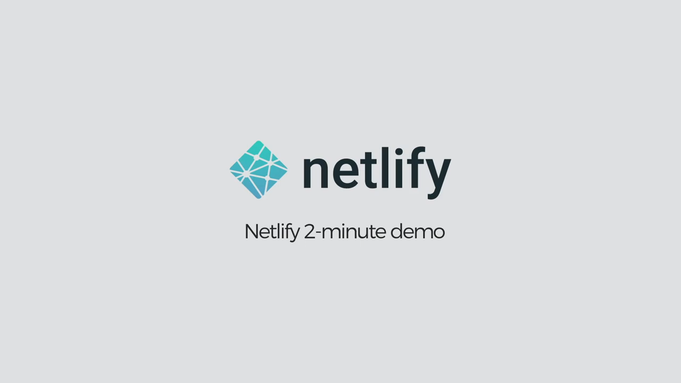

Slide 6

USES of NETLIFY

Slide 7
USES
Hosting
When it comes to use netlify then the easiest way to understand what this solution can do for you is your web applications hosting. This solution is hosting your static websites and ensures better security, performance, speed, and scalability in a more effective way. Most hosts out there are having free version. However, you can stand out with the custom domain name and HTTPS with Netlify.

Slide 8
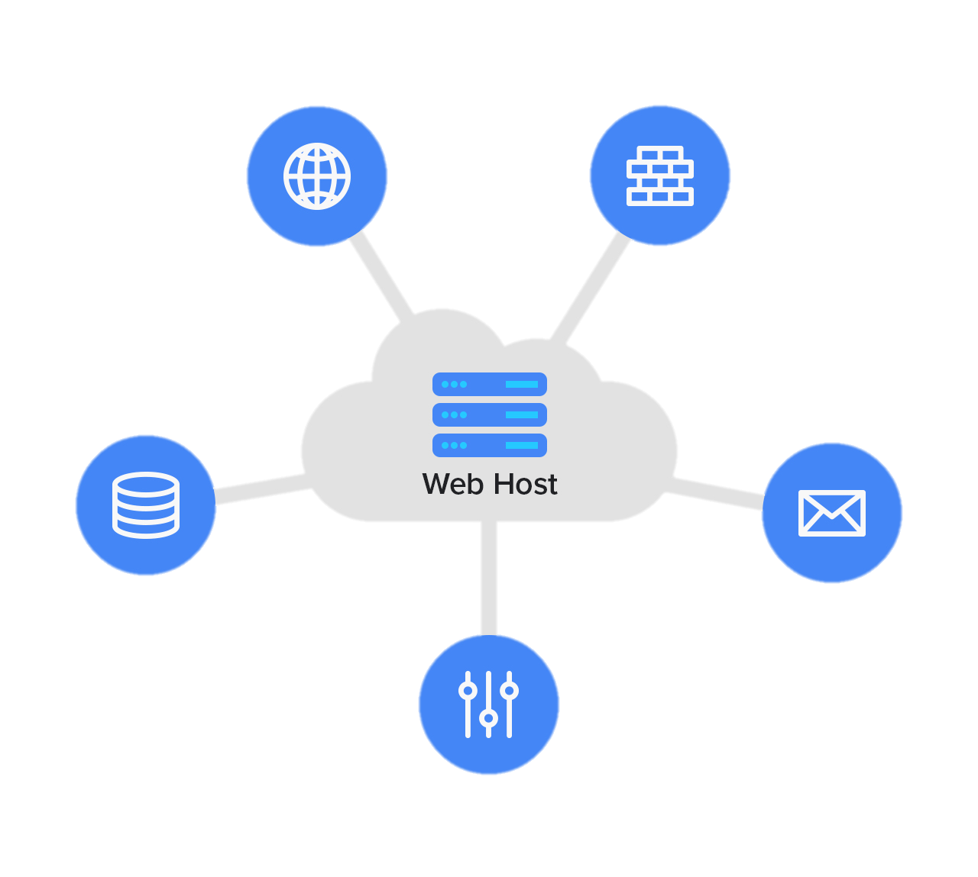

Web HOSTING SERVICE
Website
Website Builder
Web Host Server
Database
Email Accounts
Control Panel
SERVER

Slide 9
USES
Hosting
When it comes to use netlify then the easiest way to understand what this solution can do for you is your web applications hosting. This solution is hosting your static websites and ensures better security, performance, speed, and scalability in a more effective way. Most hosts out there are having free version. However, you can stand out with the custom domain name and HTTPS with Netlify.

Slide 10
USES
Serverless Functions
If you are developing your static site and don’t want to deal with backend services, you can use a third-party solution to do this.
Although your site is decoupled, netlify’s lambda service will let you do anything needed here with ease.

Slide 11
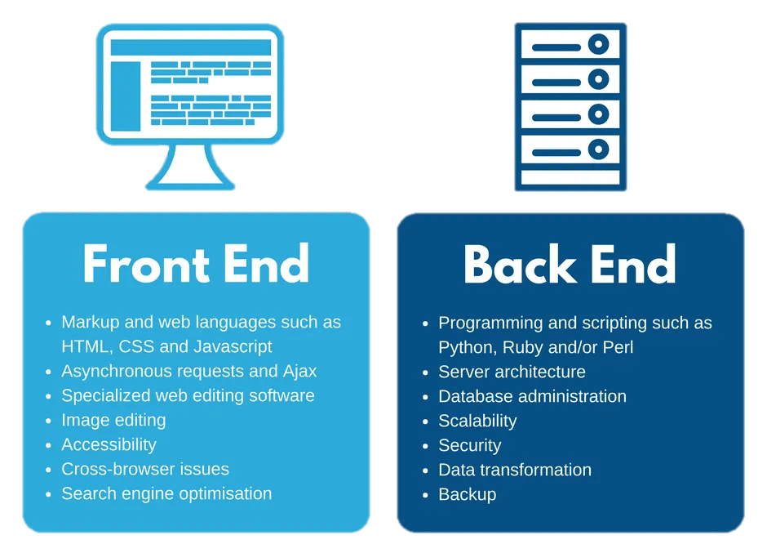

Slide 12
USES
Serverless Functions
If you are developing your static site and don’t want to deal with backend services, you can use a third-party solution to do this.
Although your site is decoupled, netlify’s lambda service will let you do anything needed here with ease.

Slide 13
USES
Forms
Add-ons
If you want to get information from your users, then creating forms is the easiest way to get done with this. Fortunately, Netlify is offering form submission feature which can let you get information from users via simple lambda function.
Netlify is offering a wider tools and applications ecosystem. You can use Netlify add-ons like forms, identity, partner integration and analytics for enhanced functionality.

Slide 14
USES
Continuous Deployment
When it comes to deploy your website, then Netlify is incredibly faster and easier with this process. You can easily setup continuous deployment by using GitLab, GitHub, or bitbucket.

Slide 15
How to use or add a new site?

Slide 16


HOW TO USE?
Git
Netlify Templates
Local Files​
Import an existing project from a Git repository
Select a prebuilt site from Netlify Templates
Deploy local project files manually using Netlify’s deploy dropzone

Slide 17
From Git repository

Slide 18
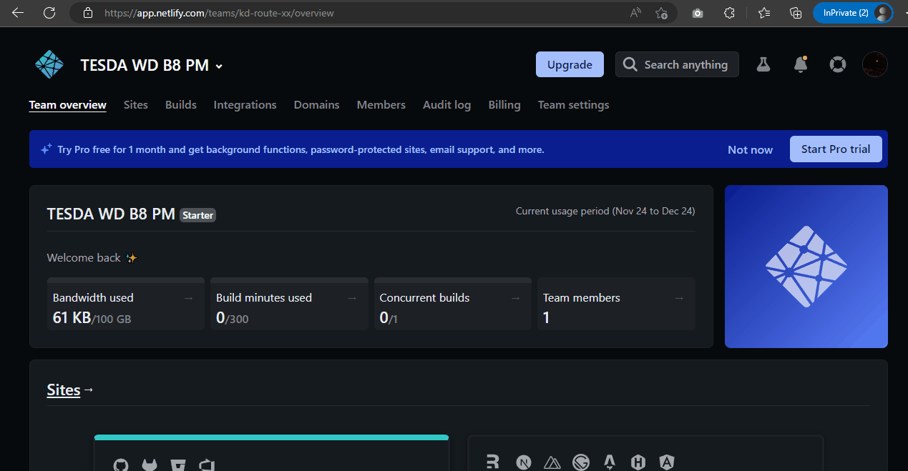
I. Import from an existing repository
Step 1: Go to your team’s Sites page, open the Add new site menu, and select Import an existing project.
Step 2: Select the Git provider where your project is hosted and authorized the link for Netlify and Github.

Slide 19
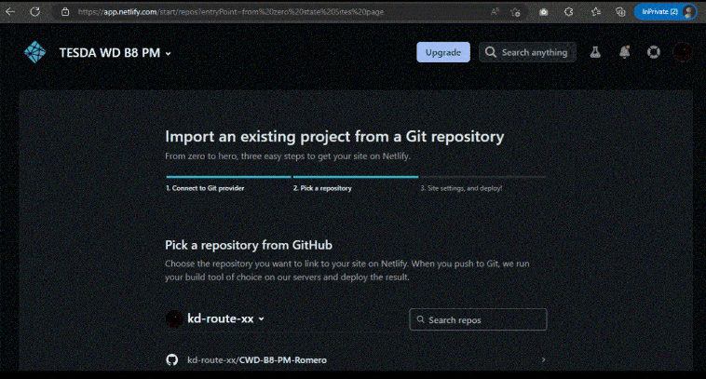
Step 4: Select your project’s existing repository.
Step 5. Adjust site and build settings
if necessary then select Deploy Site.

Slide 20
Using netlify templates

Slide 21
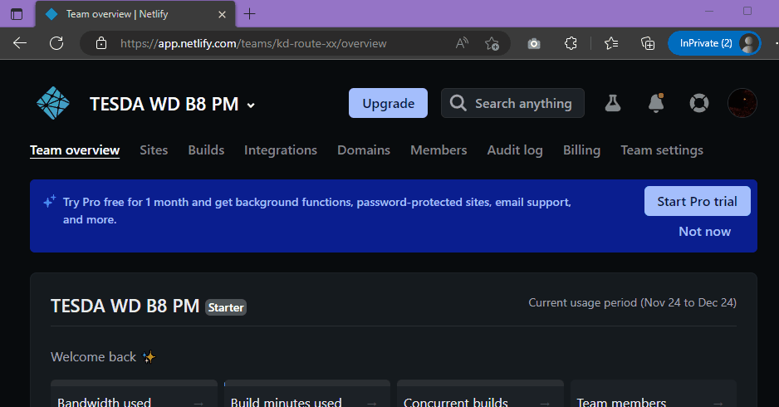
II. Use Netlify Templates
Step 1. Go to your team’s Sites page, open the Add new site menu, and select “Browse templates”.
Step 2. Select a template to use for your project. To help you choose which template to use, you can access a live demo or explore the source code to learn more.

Slide 22
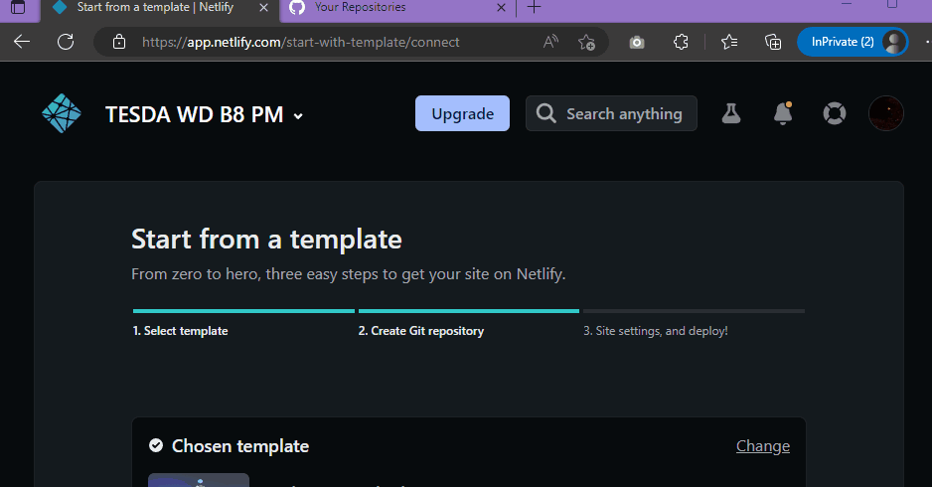
3. Choose a Git provider to create a new repository for the chosen template.
4. If necessary, edit your site and repository settings. Netlify applies some default settings, but if the values are incorrect, you can update them.

Slide 23
Deploying local files

Slide 24
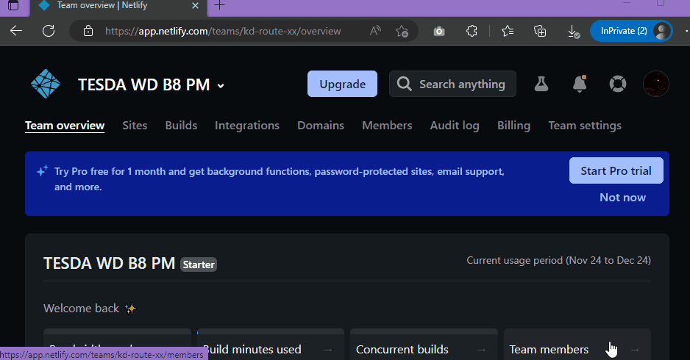
III. Deploy local files
Go to your team’s Sites page, open the Add new site menu, and select Deploy manually. Drag and drop your site’s output folder to the deploy dropzone to deploy your site.

Slide 25
Things to consider

Slide 26
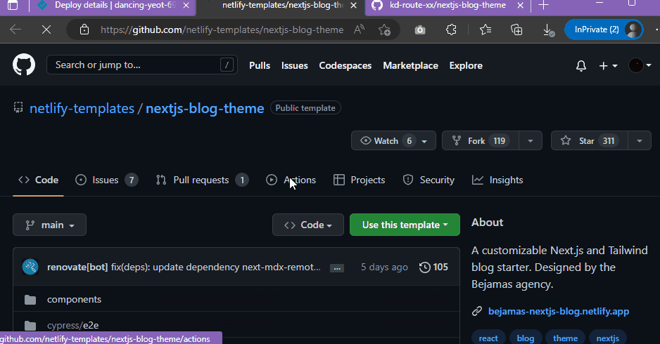
Configuring netlify Template layout

Slide 27
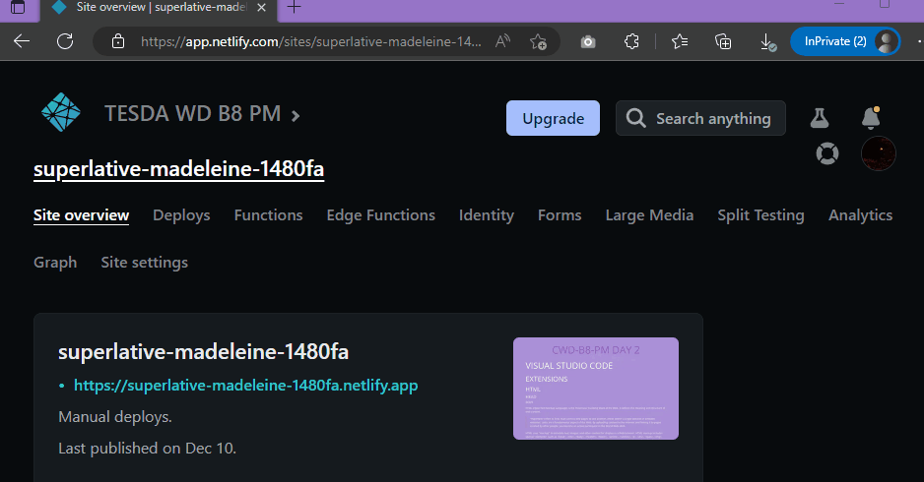
Changing website’s url

Slide 28
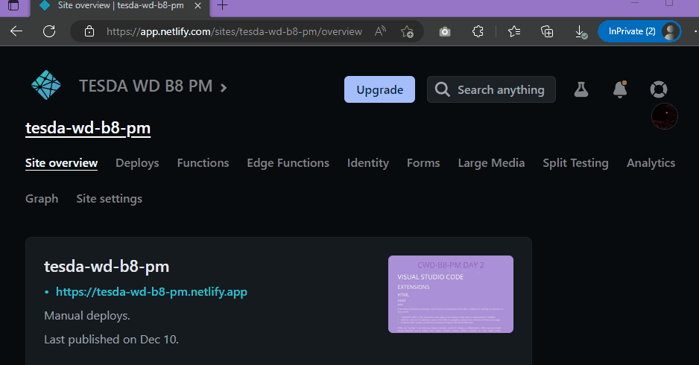
Deleting a website

Slide 29
Summary
Netlify is the platform developers love for building highly-performant and dynamic websites, e-commerce stores and web applications. By uniting an extensive ecosystem of technologies, services and APIs into one workflow, Netlify unlocks new levels of team productivity, while saving time and money.

Slide 30
Thank you
GROUP 4
MARIA CATHYLLYN DELEN
JM TAN NUDO
SAMMUEL ROMERO
LORI SANTOS
TRAINER
BOBBY FERRER

